Slide 1
Stage four deliverables
Health Eat
Group 3.2

Slide 2
Table of Contents
Demo
Heuristic Evaluation Findings
Important Problems
Changes Made
Less Important Problems
Suggestions for Future Projects

Slide 3
DEMO

Slide 4


Slide 5
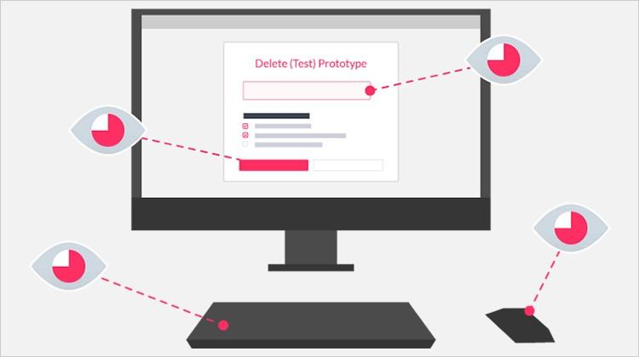
Heuristic Evaluation Findings
https://medium.muz.li/10-tips-on-how-to-conduct-a-perfect-heuristic-evaluation-ae5f8f4b3257?gi=a761d59d5185

Slide 6
Important Problems
Severity | Heuristic | Description | Suggestions
4 | Help and documentation | When inserting a new recipe, there are no form labels | Add proper labels to each input box
3 | Consistency & Standards | The Calendar page fills up with information under "Friday" even when I choose "cancel" on the "generate recipe" page | Do not add info to the friday column if cancel is chosen
3 | Consistency & Standards | The "Back" option on the "Add family members" page returns to the main page instead of the previous page | Fix the back button
3 | Recognition Rather Than Recall | When on the recipe page, the bottom right button represented with a fridge symbol brings you to a page unrelated to the symbol | Change the symbol to a more appropriate one that relates to linked page

Slide 7
Important Problems
Severity | Heuristic | Description | Suggestions
3 | Recognition Rather Than Recall | The spoon and stars symbols are ambiguous and not immediately clear | Consider implementing a mini-onboarding process in form of pop-up
2 | Visibility of System Status | Uppermost menu on homescreen does not have a proper label | Add proper labels
2 | Visibility of System Status | On the page where you can add cards, the user can continuous add more cards but the screen becomes filled and overlayed | Limit the number of cards or scrolling

Slide 8
Important Problems
Severity | Heuristic | Description | Suggestions
2 | Visibility of System Status | Not certain what the "Quick Swap" is swapping between | Add a guide to show what the function is
2 | Aesthetic and Minimalist design | When "Quick Swapping" the layouts of the surrounding icons are not consistent | Fix the layout
2 | Consistency & Standards | The "Back" option does not work on the "High Protein Omelet" page | Fix the back button
2 | Consistency & Standards | The "Replace" option on the "High Protein Omelet" returns to the main page and does not replace anything | Swap the "Replace" for "Return" or "Home"

Slide 9
Important Problems
Severity | Heuristic | Description | Suggestions
2 | Aesthetic and Minimalist design | On the calendar page the information displayed on the weekly view is too small to read | Possibly add an overlay when a day is clicked to display more clearly
2 | Match between System and Real World | When creating a new profile or account, you can submit without filling out any information | Do not allow submit until required data is there
1 | Flexibility and Efficiency of use | The expiry notifications say "soon" which is a bit vague | Consider listing the remaining shelf life

Slide 10
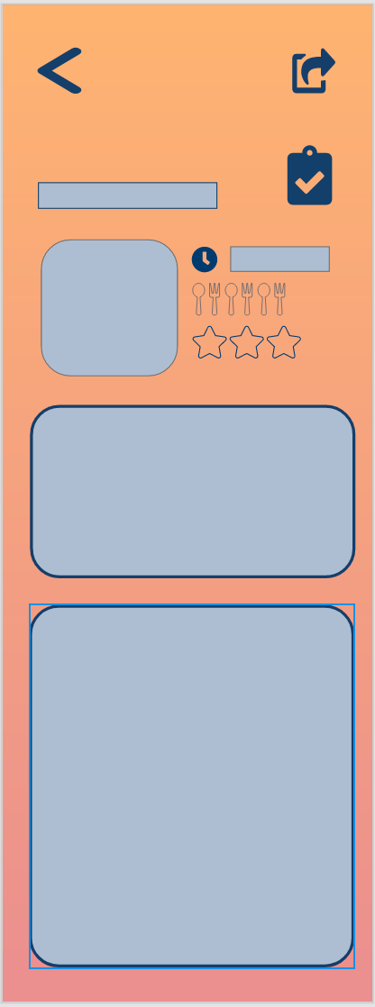
Important Problems - Changes Made
Before:
Heuristic rule: | Help and documentation
Description: | When inserting a new recipe, there are no form labels.
Suggestion for fix: | Add proper labels to each input box

Slide 11
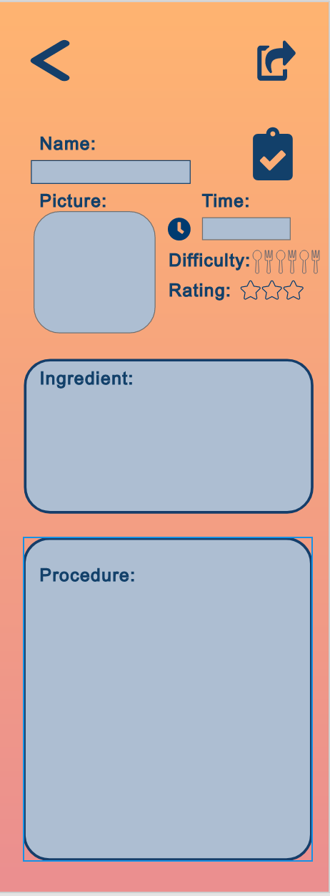
Important Problems - Changes Made
After:
Heuristic rule: | Help and documentation
Reason: | When inserting a new recipe, there are no form labels.
Fixed: | Add proper labels to each input box

Slide 12
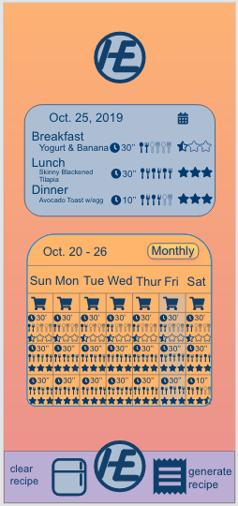
Important Problems - Changes Made
Before:
Heuristic rule: | Aesthetic and Minimalist design
Description: | On the calendar page the information displayed on the weekly view is too small to read
Suggestion for fix: | Possibly add an overlay when a day is clicked to display more clearly

Slide 13
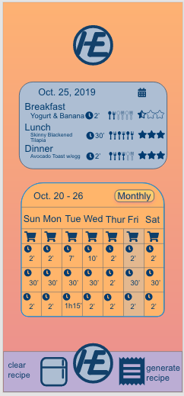
Important Problems - Changes Made
After:
Heuristic rule: | Aesthetic and Minimalist design
Reason: | On the calendar page the information displayed on the weekly view is too small to read
Fixed: | Reduce the visual load by only adding the time info. about the plate

Slide 14
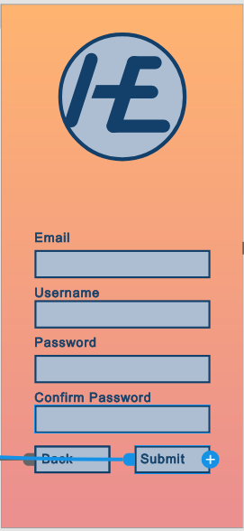
Important Problems - Changes Made
Before:
Heuristic rule: | Match between System and Real World
Description: | When creating a new profile or account, you can submit without filling out any information.
Suggestion for fix: | Do not allow submit until required data is there

Slide 15
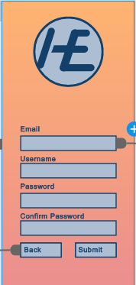
Important Problems - Changes Made
After:
Heuristic rule: | Match between System and Real World
Reason: | When creating a new profile or account, you can submit without filling out any information.
Fixed: | Do not allow submit until required data is there

Slide 16
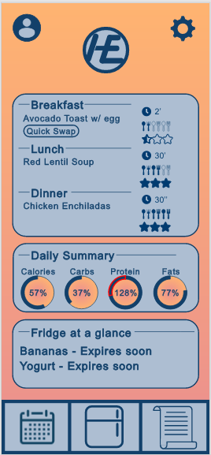
Important Problems - Changes Made
Before:
Heuristic rule: | Flexibility and Efficiency of use
Description: | The expiry notifications say "soon" which is a bit vague.
Suggestion for fix: | Consider listing the remaining shelf life

Slide 17
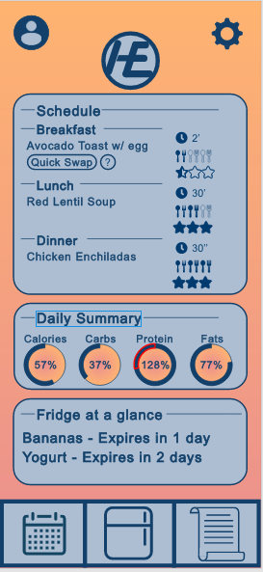
Important Problems - Changes Made
After:
Heuristic rule: | Flexibility and Efficiency of use
Reason: | The expiry notifications say "soon" which is a bit vague.
Fixed: | Consider listing the remaining shelf life

Slide 18
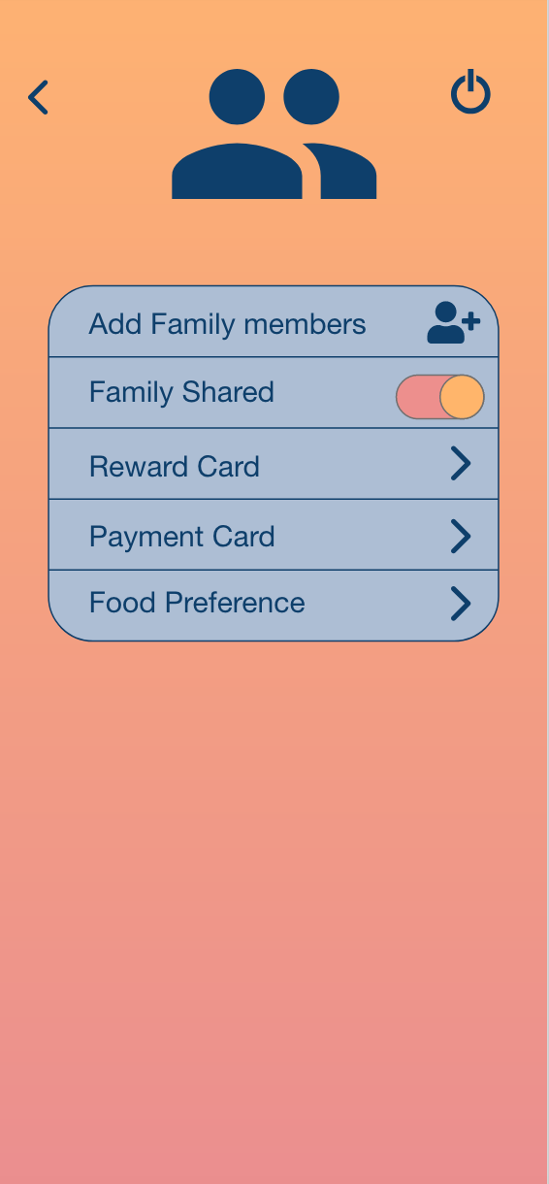
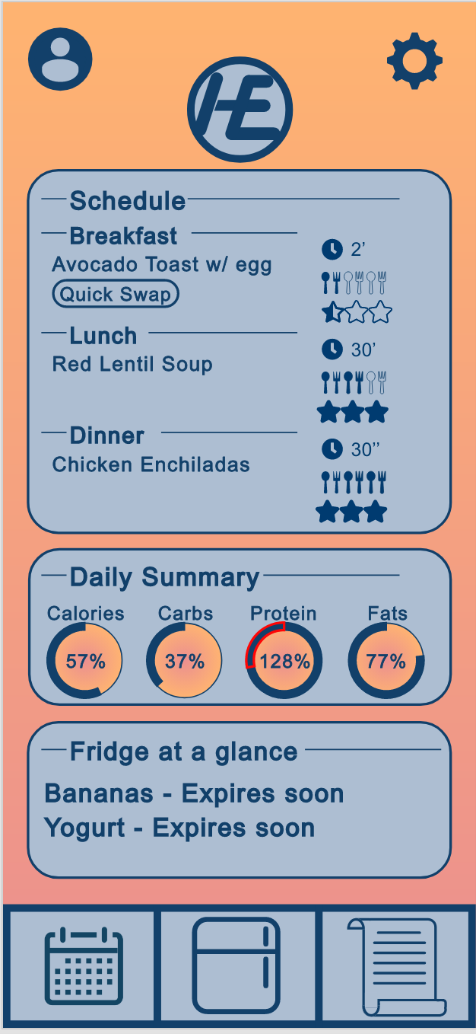
Important Problems - Changes Made
Before:
Heuristic rule: | Consistency & Standards
Description: | The "Back" option on the "Add family members" page returns to the main page instead of the previous page
Suggestion for fix: | Fix the back button

Slide 19
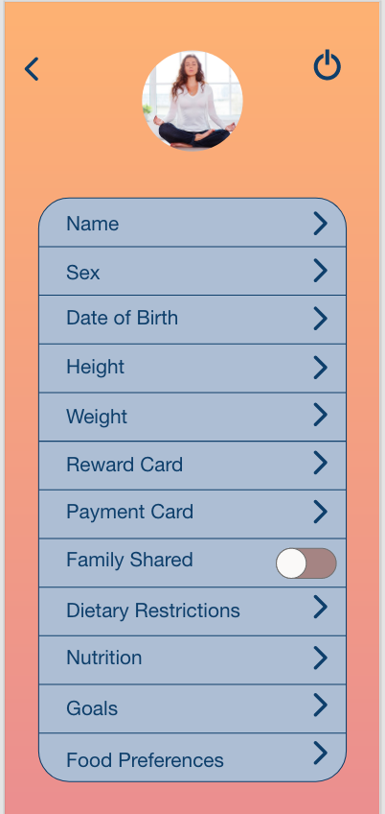
Important Problems - Changes Made
After:
Heuristic rule: | Consistency & Standards
Reason: | The "Back" option on the "Add family members" page returns to the main page instead of the previous page
Fixed: | Fix the back button

Slide 20
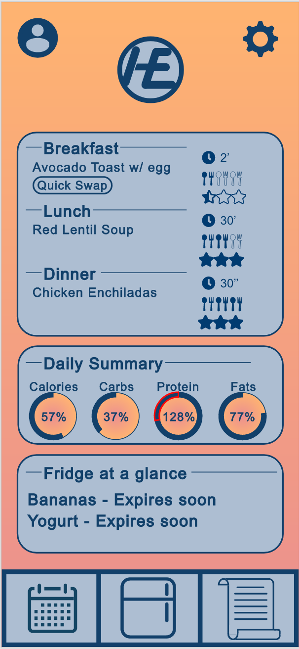
Important Problems - Changes Made
Before:
Heuristic rule: | Visibility of System Status
Description: | Uppermost menu on home screen does not have a proper label
Suggestion for fix: | Add proper labels

Slide 21
Important Problems - Changes Made
After:
Heuristic rule: | Visibility of System Status
Reason | Uppermost menu on home screen does not have a proper label
Fixed: | Add proper labels

Slide 22
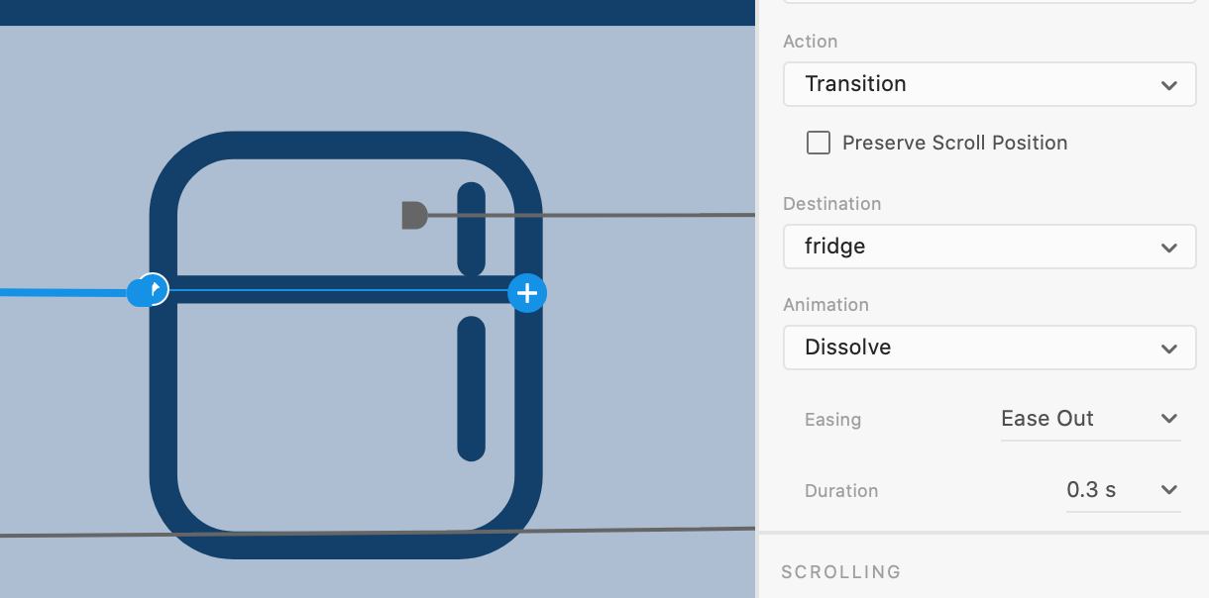
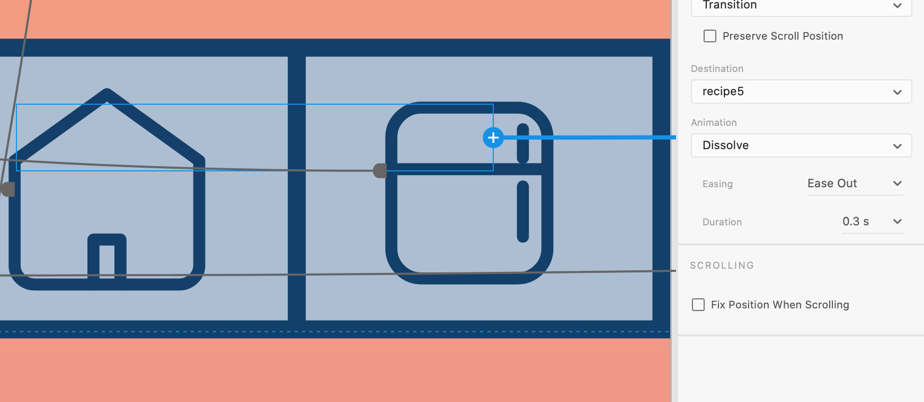
Important Problems - Changes Made
Before:
Heuristic rule: | Recognition Rather Than Recall
Description: | When on the recipe page, the bottom right button represented with a fridge symbol brings you to a page unrelated to the symbol
Suggestion for fix: | Change the symbol to a more appropriate one that relates to linked page

Slide 23
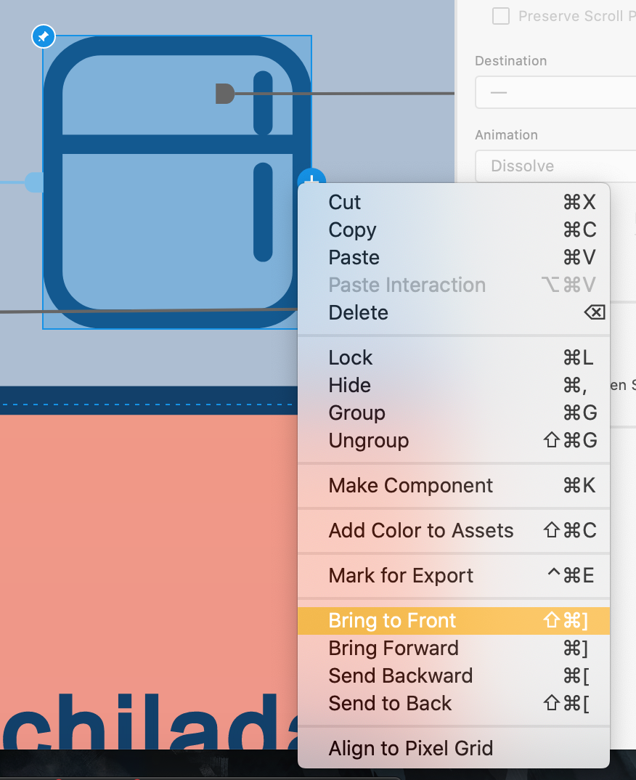
Important Problems - Changes Made
After:
Heuristic rule: | Recognition Rather Than Recall
Reason: | The active part is only a line inside that button, and there is another recipe button under that fridge button
Fixed: | Bring the button to front and make the whole symbol as button

Slide 24
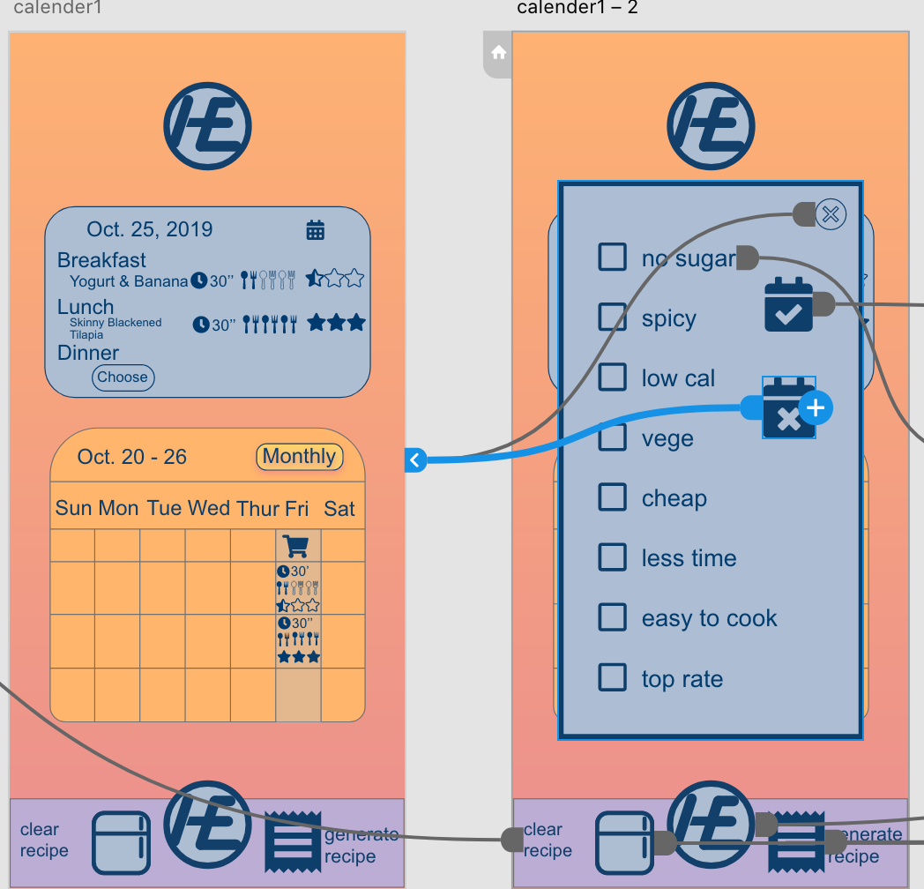
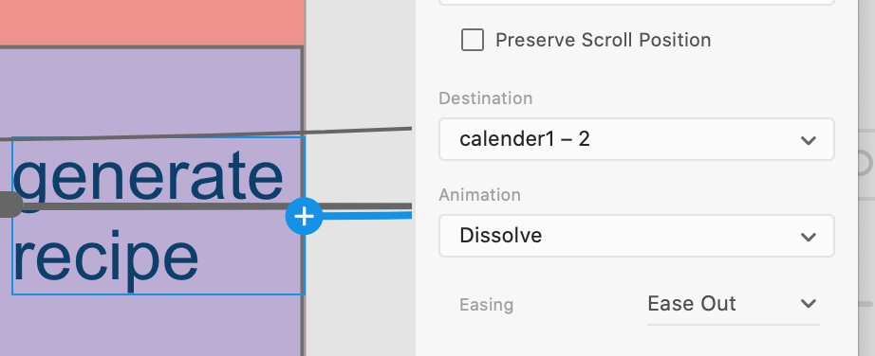
Important Problems - Changes Made
Before:
Heuristic rule: | Consistency & Standards
Description: | The Calendar page fills up with information under "Friday" even when I choose "cancel" on the "generate recipe" page
Suggestion for fix: | Do not add info to the friday column if cancel is chosen

Slide 25
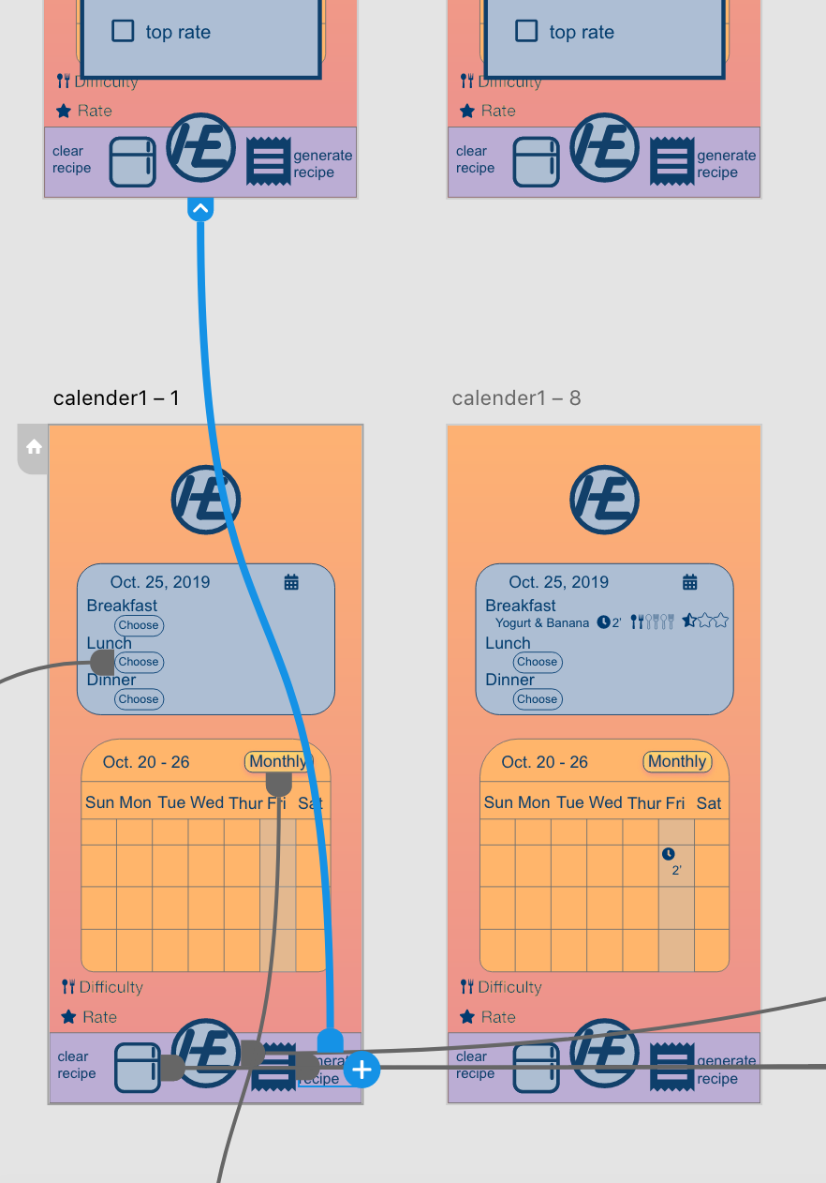
Important Problems - Changes Made
After:
Heuristic rule: | Consistency & Standards
Reason: | All the generate recipes link to the same page
Fixed: | Add more pages for the generate recipes. Link those pages individually.

Slide 26
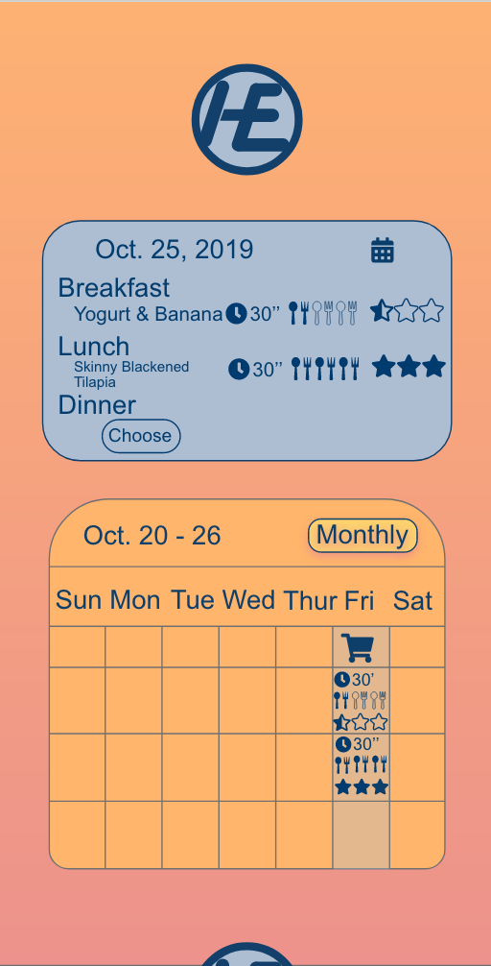
Important Problems - Changes Made
Before:
Heuristic rule: | Recognition Rather Than Recall
Description: | The spoon and stars symbols are ambiguous and not immediately clear
Suggestion for fix: | Consider implementing a mini onboarding process in form of pop-up

Slide 27
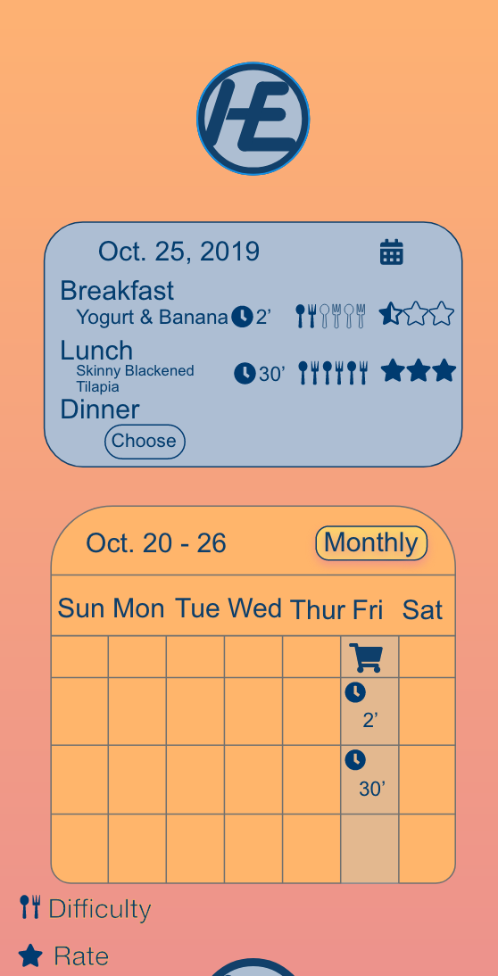
Important Problems - Changes Made
After:
Heuristic rule: | Recognition Rather Than Recall
Reason: | No description provide before.
Fixed: | Provide a small “note” inside the page

Slide 28
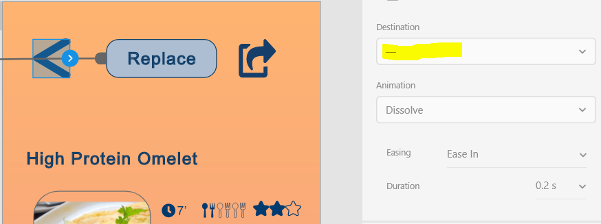
Important Problems - Changes Made
Before:
Heuristic rule: | Consistency & Standards
Description: | The "Back" option does not work on the "High Protein Omelet" page.
Suggestion for fix: | Fix the Back button

Slide 29
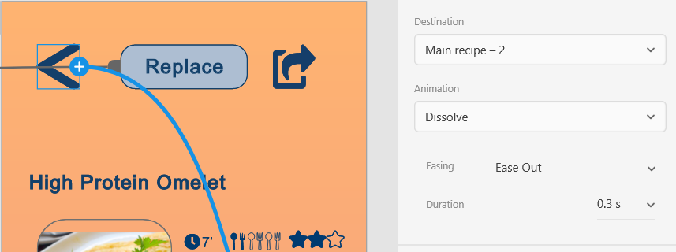
Important Problems - Changes Made
After:
Heuristic rule: | Consistency & Standards
Reason: | The Back Button was not linked.
Fixed: | Linked the back button to the previous page in workflow.

Slide 30
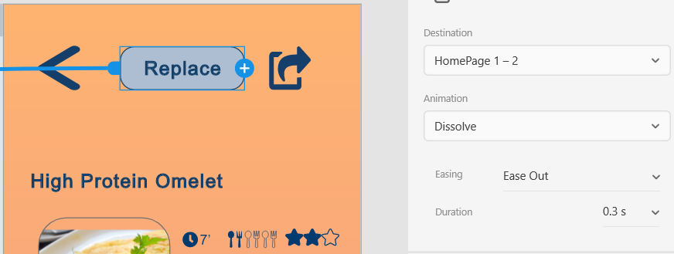
Important Problems - Changes Made
Before:
Heuristic rule: | Consistency & Standards
Description: | The "Replace" option on the "High Protein Omelet" returns to the main page and does not replace anything.
Suggestion for fix: | Swap the "Replace" for "Return" or "Home"

Slide 31
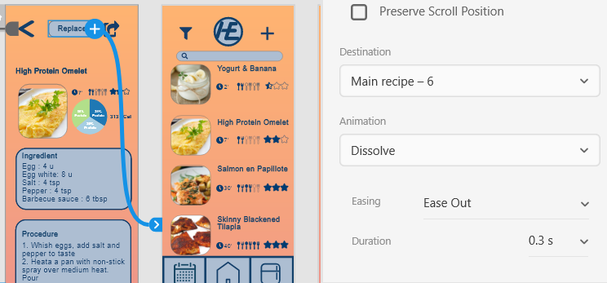
Important Problems - Changes Made
After:
Heuristic rule: | Consistency & Standards
Reason: | The incorrect page was linked to the High Protein Omelet button on the main page, this was a page for replacing the Avocado Toast
Fixed: | Duplicated originally used page and made the Replace option take you to a Recipe page with replacement options.

Slide 32
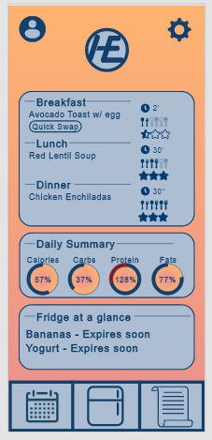
Important Problems - Changes Made
Before:
Heuristic rule: | Visibility of System Status
Description: | Not certain what the "Quick Swap" is swapping between
Suggestion for fix: | Add a guide to show what the function is.

Slide 33
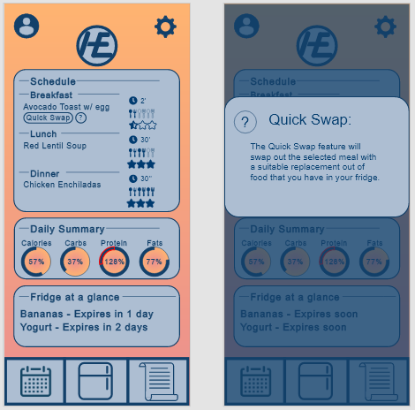
Important Problems - Changes Made
After:
Heuristic rule: | Visibility of System Status
Reason: | The “quick swap” button was first created to show the usage of the nutrition graphs on the home screen.
Fixed: | Added a pop-up to describe the function of the button.

Slide 34
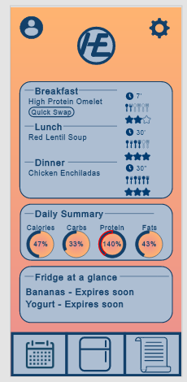
Important Problems - Changes Made
Before:
Heuristic rule: | Aesthetic and Minimalist design
Description: | When "Quick Swapping" the layouts of the surrounding icons are not consistent
Suggestion for fix: | Fix the layout

Slide 35
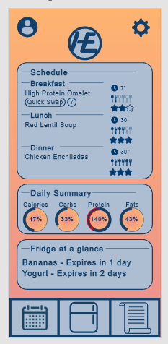
Important Problems - Changes Made
After:
Heuristic rule: | Aesthetic and Minimalist design
Reason: | When the two menus were created, the symbols were not properly aligned.
Fixed: | Fixed the alignment

Slide 36
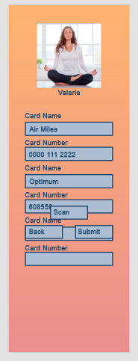
Important Problems - Changes Made
Before:
Heuristic rule: | Visibility of System Status
Description: | On the page where you can add cards, the user can continuous add more cards but the screen becomes filled and overlayed
Suggestion for fix: | Limit the number of cards or scrolling

Slide 37
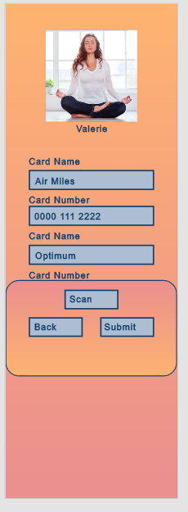
Important Problems - Changes Made
After:
Heuristic rule: | Visibility of System Status
Reason: | The user should be able to access the submit and back buttons while scrolling but the buttons clashed with the input boxes.
Fixed: | A background was added

Slide 38
Less Important Problems
Severity | Heuristic | Description | Suggestions
3 | User Control and Freedom | In meal planning the user is limited to 3 meals a day. | Consider allowing for more flexible scheduling

Slide 39
Suggestions for Future Projects
Severity | Heuristic | Description | Suggestions
1 | Aesthetic and Minimalist design | The blue used looks like grey which doesn't look good, gives it an old look | Make the colour more blue or use different colour scheme
1 | Aesthetic and Minimalist design | Some blue boxes could look better with some transparency | Play around with different levels of Transparency to give the app some depth

Slide 40
Thank you!

